Slide 1
MKU
School of Medicine
MBMP 1323 : Cardiovascular Physiology II
Topic: The Vasculature
By J. Alfred, BSc, MSc, MA, PhD cont.
Email: alfredjuma2015@yahoo.com

Slide 2
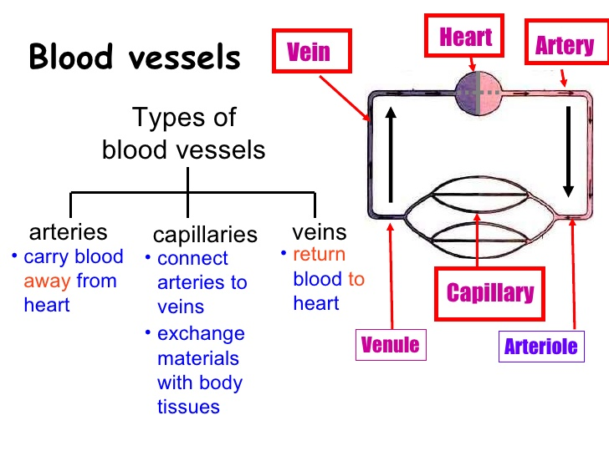

Slide 3
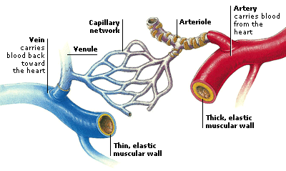
BLOOD VESSEL STRUCTURE AND FUNCTION
Five types of blood vessels:
(1) Arteries
Two large arteries are the aorta and pulmonary trunk
(2) Arterioles
(3) Capillaries
(4) Veins
(5) Venules
The average adult has over 60,000 miles of blood vessels in their body.
Notes:
Five types of blood vessels:
(1) Arteries
Carry blood away from the heart to body tissues
Two large arteries are: _aorta_ and _pulmonary trunk_ branch out from the heart go to small arteries
(2) _Arterioles_
Small arteries found in organs, branch out into capillaries
(3) _Capillaries_
Microscopic vessels that branch off of arterioles in organs
(4) _Veins_
Small veins formed by groups of capillaries within a tissue that reunite
(5) _Venules_
Larger vessels formed by merging venules; convey blood from tissues back to the heart

Slide 4
Distribution of Blood Volume
Systematic arteries and arterioles 15%
Systematic veins and venules 60%
Systematic capillaries 5%
Pulmonary blood vessels 12%
Heart chambers 8%
Veins and venules contain so much blood, thus certain veins serve as blood reservoirs from which stored blood can be diverted to other parts of the body

Slide 5
Basic structure
3 layers or tunics
Tunica interna (intima)
Tunica media
Tunica externa
Modifications account for 5 types of blood vessels and their structural/ functional differences

Slide 6
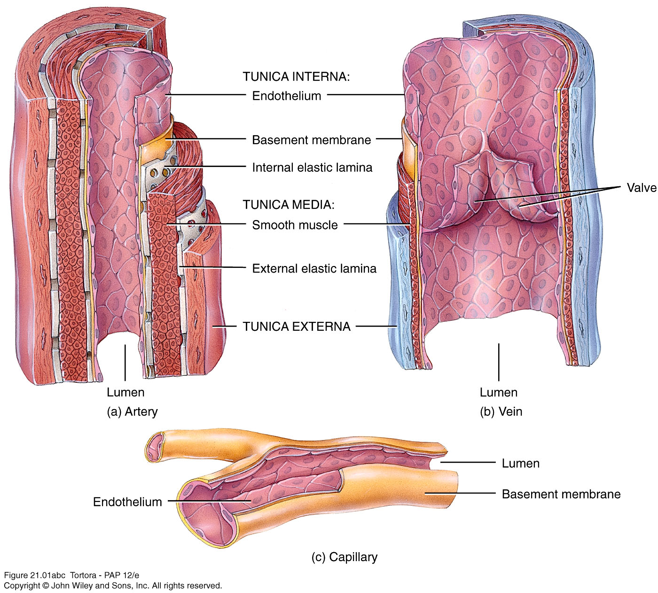

Slide 7
Structure
Tunica interna (intima)
Inner lining in direct contact with blood
Endothelium continuous with endocardial lining of heart
Active role in vessel-related activities
Tunica media
Muscular and connective tissue layer
Greatest variation among vessel types
Smooth muscle regulates diameter of lumen
Tunica externa
Elastic and collagen fibers
Vasa vasorum
Helps anchor vessel to surrounding tissue

Slide 8
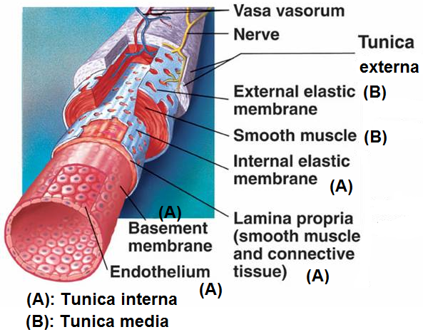
Arteries and Arterioles
The lumen is the hollow space through which the blood flows.
Three layers surrounding the lumen:
Tunica interna
Tunica media
Tunica externa
Notes:
Tunica interna_: inner layer; endothelium composed of simple squamous epithelium, a basement membrane, and an elastic tissue (internal elastic lamina)
Tunica media_: middle layer; smooth muscle and elastic tissue
Tunica externa_: outer layer; mainly elastic and collagen fibers

Slide 9
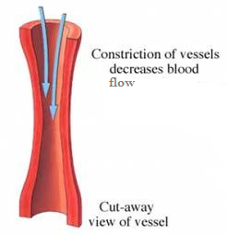
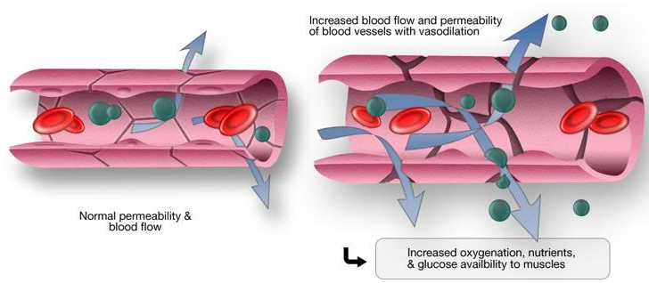
Vasoconstriction → decrease in the size of the lumen
Vasodilation → increase in the size of the lumen
Notes:
Vasoconstriction: decrease in the size of the lumen of a blood vessel.
Cause: increase in sympathetic stimulation that causes smooth muscle to contract, squeezing vessel walls and narrowing lumen.
Increases blood pressure….
_Vasodilation_: increase in the size of the lumen of a blood vessel.
Cause: decrease in sympathetic stimulation that causes smooth muscle to relax, expanding vessel walls and widening lumen.
Decreases blood pressure

Slide 10
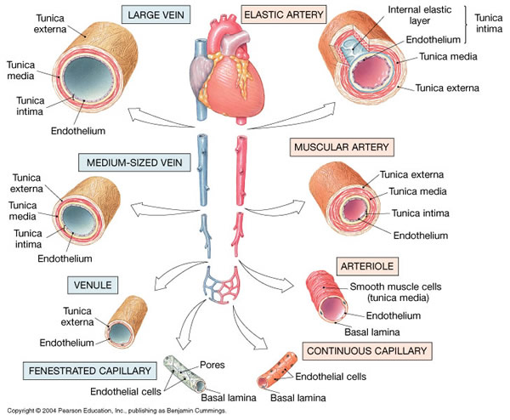
Notes:
_Elastic arteries_: largest-diameter arteries; a lot of elastic fiber in middle layer, walls pretty thin; propel blood onward when ventricles relaxed. Elasticity needed to accommodate surge of blood coming from heart as it pumps.
_Muscular arteries_: medium-sized arteries; contain more smooth muscle; capable of greater vasoconstriction and vasodilation to adjust rate of blood flow.
_Arteriole_: very small artery; delivers blood to capillaries; regulate blood flow from arteries to capillaries (vasoconstriction = blood flow artery to capillary restricted; vasodilation = flow is increased)

Slide 11
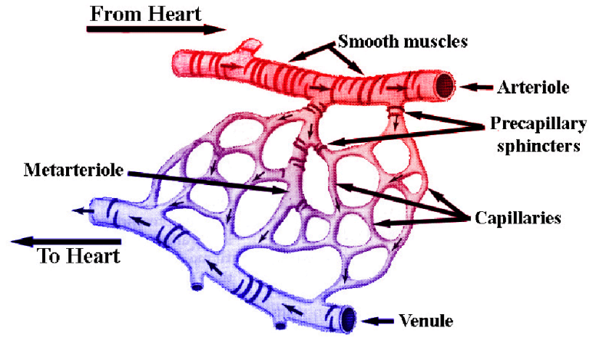
Capillaries
Connect arterioles and venules
AKA: exchange vessels→ permit exchange of nutrients and waste between body cells and blood
Areas with high metabolic requirements have extensive capillary networks
muscles, liver, kidneys, nervous system
Areas with very low metabolic requirements lack capillaries
cornea and lens of the eye, nails, hair follicles, cuticles, cartilage

Slide 12
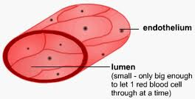
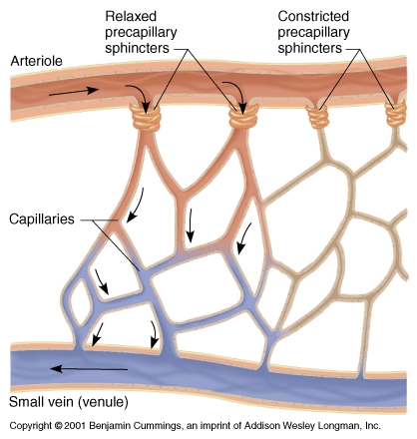
Structure of Capillaries
Walls consist of single layer of endothelial cells
Precapillary sphincters→ rings of smooth muscle at meeting point of capillary to arteriole
Notes:
Walls consist of single layer of endothelial cells_Thus substances pass across them easily…
_Precapillary sphincters_: rings of smooth muscle at meeting point of capillary to arteriole; along with smooth muscle fibers in arterioles regulate flow of blood (when sphincters relaxed = more blood flows; when sphincters contracted= less blood flow)

Slide 13
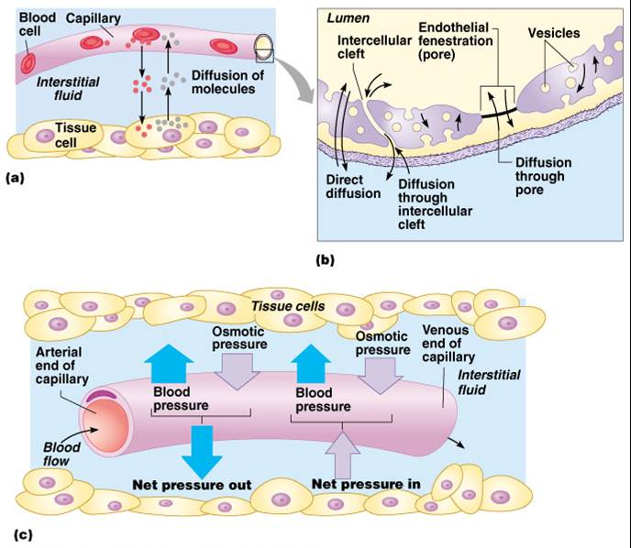
Capillary Exchange
Two methods of exchange
Diffusion
Bulk Flow
Notes:
Exchange of Fluid between Capillaries and Tissues
Hydrostatic pressure, capillary permeability, and osmosis affect movement of fluid into and out of capillaries
A net movement of fluid occurs from blood into tissues – bulk flow
Distribution of extracellular fluid (ECF) between plasma and interstitial compartments
Is in state of dynamic equilibrium.
Is a balance between pressures in the tissue fluid and blood plasma
Hydrostatic Pressure:
Is the pressure exerted against the inner capillary wall
Promotes formation of tissue fluid
Across a capillary bed, the hydrostatic pressure quickly drops as blood moves from the higher pressure arteriole end to the lower pressure venule end
Net filtration pressure
Colloid osmotic pressure:
This is the pressure exerted by plasma proteins
Promotes fluid reabsorption into circulatory system
Is constant across the capillary bed because the concentration of nonpenetrating solutes does not change from one of the capillary bed to the other

Slide 14
Diffusion
Oxygen and nutrients → down the gradient into interstitial fluid and then into body cells
Carbon dioxide and waste → down the gradient from interstitial fluids into the blood for removal
Glucose
Amino acids
Hormones
Plasma proteins usually remain in blood; too large to pass through
Exceptions:
Sinusoids the smallest blood vessels in the liver have very large gaps in between their endothelial cells to allow proteins (fibrinogen, main clotting protein, and albumin) to enter bloodstream
Other areas are very selective:
Blood-brain barrier refers to the tightness of endothelial layer found in brain; allows only a few substances to enter and leave

Slide 15
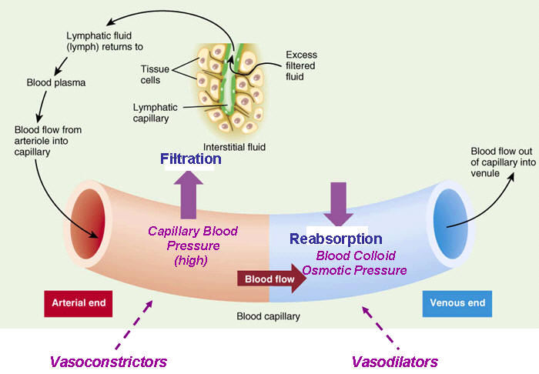
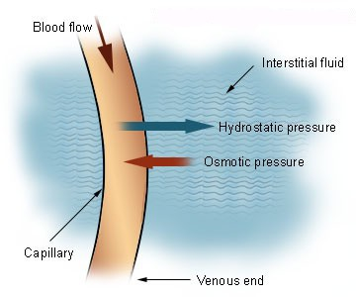
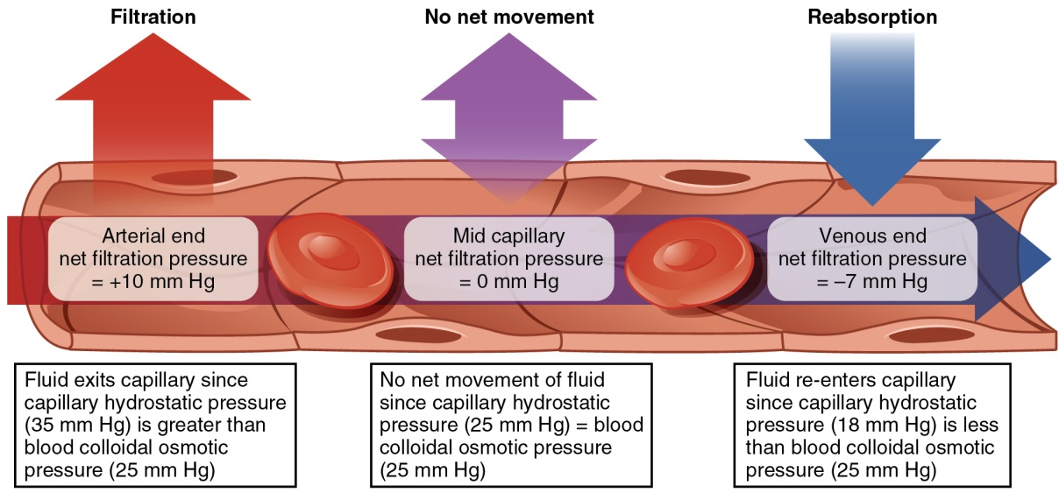
Bulk Flow (Filtration and Reabsorption)
Notes:
Passive process from area of higher pressure to lower pressure, for as long as a pressure differs occurs
_Ions_, _molecules_ or _particles_ in a fluid; move together, same direction
Two opposing pressures = _capillary blood pressure (hydrostatic pressure)_ and _blood colloid osmotic pressure_
_Capillary blood pressure_: pressure of blood against capillary walls, “pushes” fluid out of capillaries into interstitial fluid
_Filtration_: movement of water and solutes from capillaries to interstitial fluid
_Blood colloid osmotic pressure_: opposing pressure “pulls” fluid into capillaries
_Reabsorption_: movement of water and solutes from interstitial fluid into blood capillaries
_Autoregulation_: ability of a tissue to automatically adjust its blood flow to match its metabolic demands

Slide 16
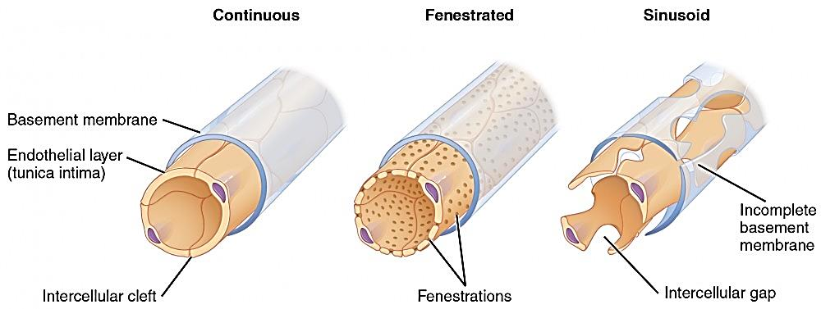
Types of Capillaries
Capillaries are the smallest and thinnest of the blood vessels in the body and also the most common.
Continuous capillary the most common type of capillary, the continuous capillary, is found in almost all vascularized tissues.
Continuous capillaries are characterised by a complete endothelial lining with tight junctions between endothelial cells. Although a tight junction is usually impermeable and only allows for the passage of water and ions.

Slide 17
Starling’s Law
Nearly as much reabsorbed as filtered
At the arterial end, net outward pressure of 10 mmHg and fluid leaves capillary (filtration)
At the venous end, fluid moves in (reabsoprtion) due to -9 mmHg
On average, about 85% of fluid filtered in reabsorpbed
Excess enters lymphatic capillaries (about 3L/ day) to be eventually returned to blood

Slide 18
Fenestrated capillary is one that has pores (or fenestrations), in addition to tight junctions in the endothelial lining. These make the capillary permeable to larger molecules. The number of fenestrations and their degree of permeability vary, however, according to their location.
Fenestrated capillaries are common in the small intestine, which is the primary site of nutrient absorption, as well as in the kidneys, which filter the blood. They are also found in the choroid plexus of the brain.

Slide 19
Sinusoid capillary (or sinusoid) is the least common type of capillary. Sinusoid capillaries are flattened, and they have extensive intercellular gaps and incomplete basement membranes, in addition to intercellular clefts and fenestrations.
These very large openings allow for the passage of the largest molecules, including plasma proteins and even cells. Blood flow through sinusoids is very slow, allowing more time for exchange of gases, nutrients, and wastes.

Slide 20
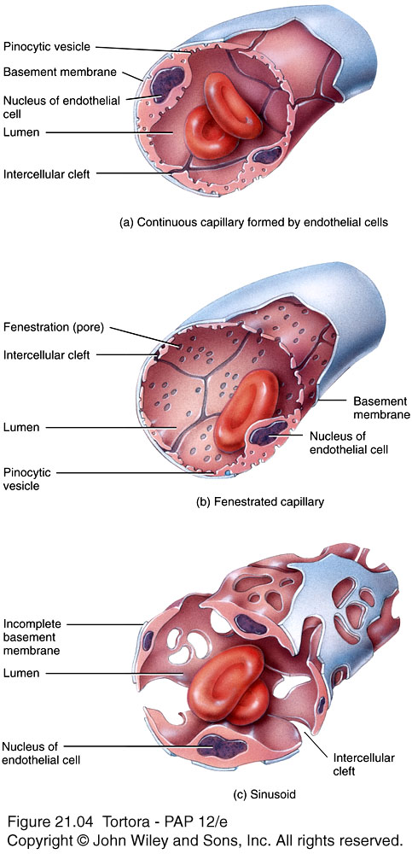
Summary of Capillaries
3 types
Continuous
Endothelial cell membranes from continuous tube
Fenestrated
Have fenestrations or pores
Sinusoids
Wider and more winding
Unusually large fenestrations

Slide 21
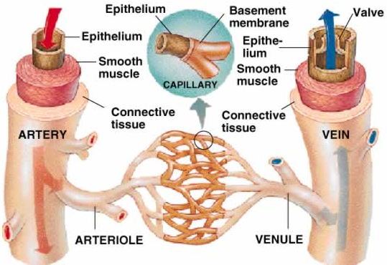
Venules and Veins
Capillaries unite to form venules (small veins)
Venules receive blood from capillaries and empty it into veins
Veins return blood to the heart

Slide 22
Veins
Structural changes not as distinct as in arteries
In general, very thin walls in relation to total diameter
Same 3 layers
Tunica interna thinner than arteries
Tunica interna thinner with little smooth muscle
Tunica externa thickest layer
Not designed to withstand high pressure
Valves – folds on tunica interna forming cusps
Aid in venous return by preventing backflow

Slide 23
Structure of Venules and Veins
Venules
little veins; walls thinner at capillary end, thicker as they progress toward heart
Veins
structural similar to arteries; middle and inner layers thinner than arteries, outer layers are the thickest

Slide 24
Generally, lumen of veins wider than that of corresponding artery

Slide 25
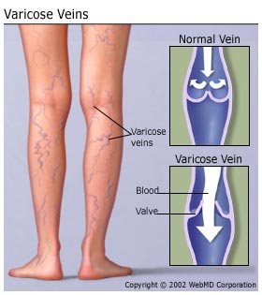
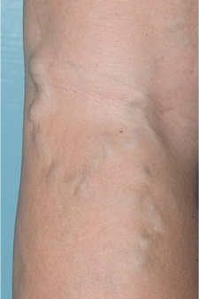
Inner layer forms valves to prevent backflow of blood
Sometimes this causes problems
Varicose veins
Weak venous valves
Gravity forces blood backwards
through the valve increasing venous
blood pressure
Increased pressure pushes the vein’s wall outward
Veins receive repeated overloads, walls lose elasticity, stretch become flabby

Slide 26
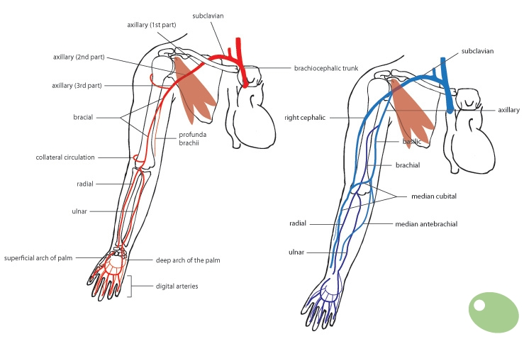
Blood flows out of a vein slowly and more rapidly out of an artery
WHY should you not start an IV in an artery???
Notes:
That happened to me one time, but in my case, the blood went all the way up to the hanging bottle - fast! so there was no question it was an artery. So I removed it, of course, applied some pressure to prevent hematoma, then started over & found a vein. QUESTION: I am unclear whether you left that line in: it certainly sounds like an artery (just smaller than the one I got into). I would imagine the main potential problems would be: bleeding, & the person not getting the medicine ordered iv. I wonder why we don't learn about that; you are now the 3rd nurse who I have heard of, doing this --- so I think it is not too rare

Slide 27
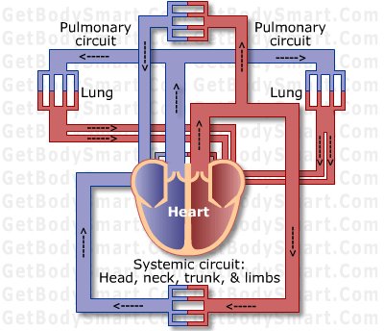
CIRCULATORY ROUTES
Blood vessels are organized in circulatory routes that carry blood throughout the body
Two main circulatory routes
Systemic
Pulmonary

Slide 28
Systemic Circulation
Arteries and arterioles carry blood containing oxygen and nutrients from left ventricle to systemic capillaries throughout body
Veins and venules carry blood containing carbon dioxide and waste to the right atrium
Blood that leaves the aorta and travels through systemic arteries is bright red
Blood moves through the capillaries, loses oxygen and takes on carbon dioxide becoming dark red in color

Slide 29
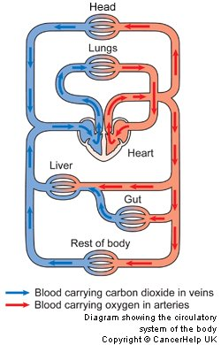
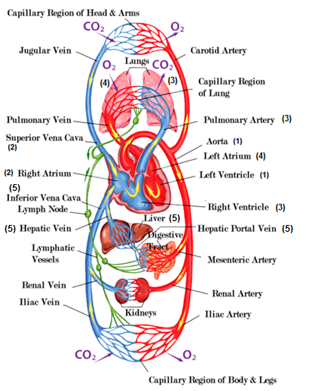
Notes:
Systemic Circulation:
All systemic arteries branch off of aorta, which arises from left ventricle of the heart carrying oxygenated blood to all parts of the body.
Deoxygenated blood returns to the heart through systemic veins; superior vena cava to inferior vena cava (coronary sinus) to right atrium.
Pulmonary Circulation:
When deoxygenated blood returns to the heart from the systemic route, it is pumped out the right ventricle through the pulmonary artery into the right lung where it loses CO₂.
Blood moves into the left lung, picks up O₂, and then returns to left atrium of heart, to once again go through systemic circulation.
Hepatic Portal Circulation:
Hepatic portal vein carries blood from one capillary network to another, namely from the GI to the liver. In the liver substances from the GI tract are processed before pushed out the hepatic vein into the inferior vena cava for circulation throughout the body.

Slide 30
Pulmonary Circulation
When deoxygenated blood returns to the heart from the systemic route, it is pumped out the right ventricle through the pulmonary artery into the right lung where it loses CO₂.
Blood moves into the lung, picks up O₂, and then returns to left atrium of heart, to once again go through systemic circulation.
We will place more focus on this when we discuss the heart…

Slide 32
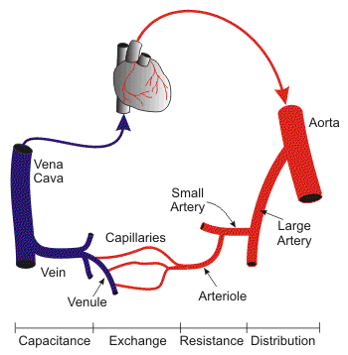
Venous Return
Volume of blood flowing back to heart through veins, occurs through pressure generated in three ways:
Contractions of the heart
Skeletal muscle pump
Respiratory pump

Slide 33
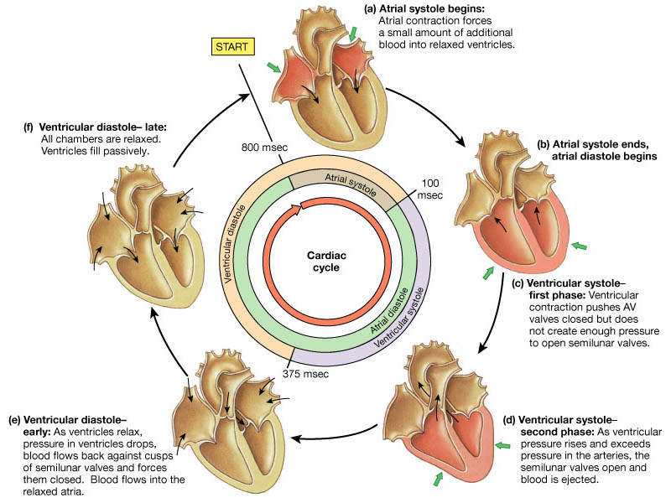
Contractions of the Heart
Notes:
Contractions of the heart
BP (systolic and diastolic) generated by contraction of heart’s ventricles and measured in millimeters of mercury (Hg)

Slide 34
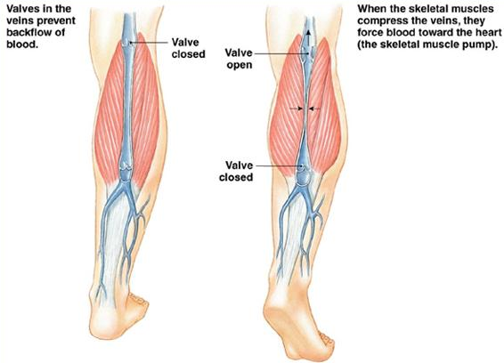
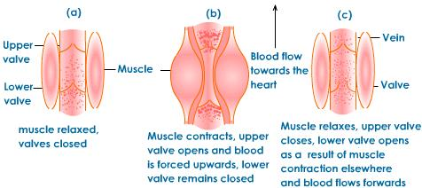
Skeletal Muscle Pump
Notes:
Skeletal muscle pump_
Locomotory activity promotes venous return, i.e. walking, running. Veins in legs and arms have one-way valves that direct flow away from limb to the heart. Muscles compress (contraction phase) the veins propels blood forward through distal (upper) valves. Muscles decompress (relaxation phase) proximal valves open, blood flows into and fills venous segment. Both of these work together to create enough pressure to propel blood to heart.

Slide 35
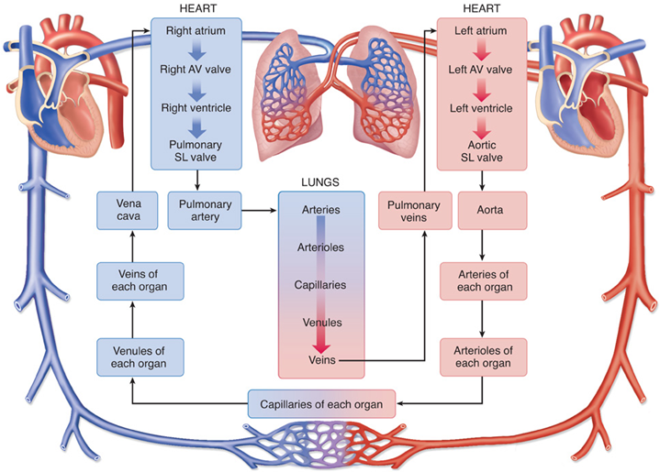
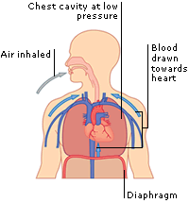
Respiratory Pump
Notes:
_Respiratory pump_
Also based on alternating compression and decompression of veins. You inhale, diaphragm moves downward = decrease in pressure in thoracic cavity, abdominal veins are compressed, thus blood moves from compressed abdominal veins to decompressed thoracic veins and then into right atrium of heart. You exhale; valves in veins prevent backflow of blood from thoracic to abdominal veins.

Slide 36
BLOOD FLOW THROUGH BLOOD VESSELS
From areas of higher pressure to areas of lower pressure
greater the pressure difference the greater the blood flow
Contractions of the ventricles generate blood pressure (BP)
Blood pressure is the measure of pressure exerted by blood on the walls of a blood vessel
highest in the aorta and large systemic arteries

Slide 37
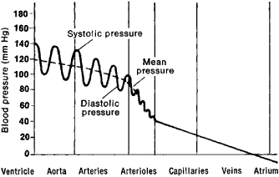
Systolic versus Diastolic
Systolic (contraction) measures maximum arterial pressure occurring during contraction of the left ventricle of the heart
Average = 120mm Hg
High end begins = 140mmHg
Diastolic (relaxation) measures arterial pressure during the interval between heartbeats
Average = 80mm Hg
High end begins = 90mmHg

Slide 38
Resistance
Vascular resistance → opposition to blood flow due to friction between blood and the walls of blood vessels
Increase in vascular resistance = increase in BP
Decrease in vascular resistance = decease in BP
Vascular resistance is dependent upon:
Size of the blood vessel (lumen)
Smaller means greater resistance to blood flow; alternates between vasoconstriction and vasodilation
Blood viscosity
Ratio of RBCs to plasma volume
Higher viscosity = higher resistance
Total blood vessel length
Resistance increase with total length
Longer the length = greater contact between vessel wall and blood

Slide 39
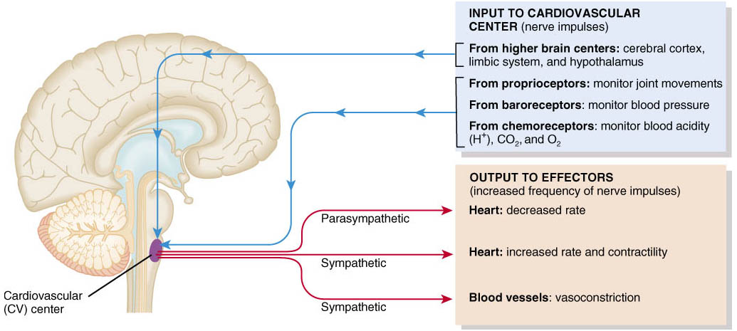
Regulation of Blood Pressure and Blood Flow
Role of the Cardiovascular Center
Cardiovascular Center (CV) in the medulla oblongata regulates heart rate and stroke volume
Notes:
Done thru interconnected negative feedback systems that control BP and blood flow by adjusting heart rate, stroke volume, vascular resistance, and blood volume
CV also controls neural and hormonal negative feedback systems that regulate BP and blood flow to specific tissues
INPUT: from higher brain regions; cerebral cortex, limbic system, and hypothalamus…do things like increase heart rate in coordination with nerve impulses (excited), vasodilation of blood vessels allows heat to dissipate to surface of skin
Input from sensory receptors; proprioceptors → monitor movement of joints/muscles = increase in heart rate during physical activities; baroreceptors → in aorta, internal carotid arteries (neck to brain) and other large arteries of neck/chest sends impulses to regulate BP; chemoreceptors → monitor blood levels of oxygen, carbon dioxide, and hydrogen ions trigger vasoconstriction to increase pressure
OUTPUT: READ CHART IN PIC…

Slide 40
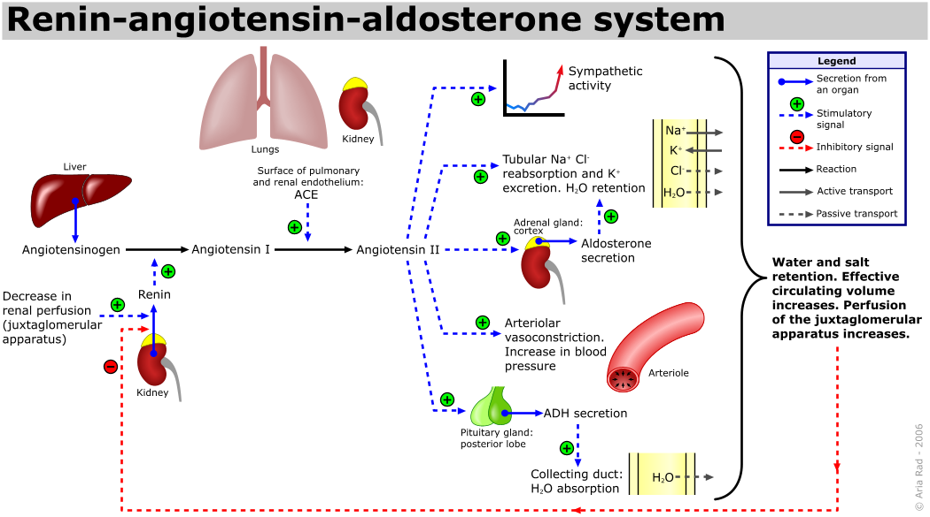
Hormonal Regulation of Blood Pressure and Blood Flow
(RAA system):
Notes:
if blood volume falls or blood flow to kidneys decreases, RAA system works to raise BP through vasoconstriction and increase reabsorption of sodium and water to increase blood volume

Slide 41
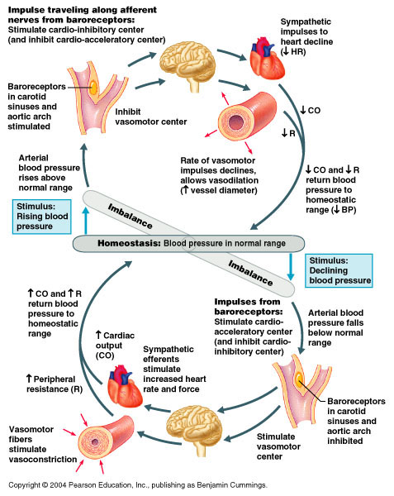
Epinephrine and norepinephrine
Notes:
respond to sympathetic stimulation, adrenal medulla releases these to increase cardiac output by increasing the rate and force of heart contractions; causes vasoconstriction

Slide 42
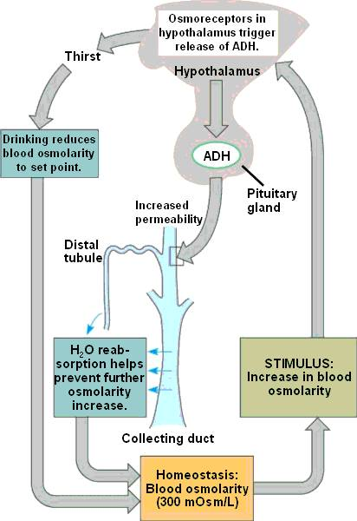
Antidiuretic hormone (ADH)
Notes:
produced by hypothalamus, released by posterior pituitary in response to dehydration or decreased blood volume; causes vasoconstriction to increase BP; thus ADH is known as vasopressin----YOU NEED A DRINK

Slide 43
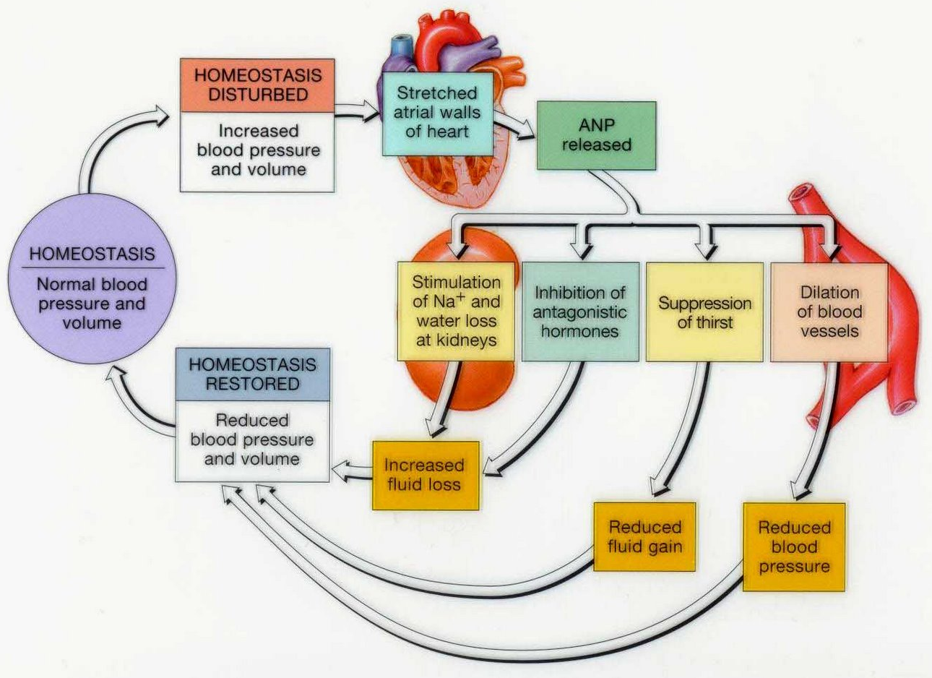
Atrial natriuretic peptide (ANP)
Notes:
released by cells in atria of heart; lowers BP, cause vasodilation, promotes loss of salt and water in urine, thus reducing blood volume

Slide 44
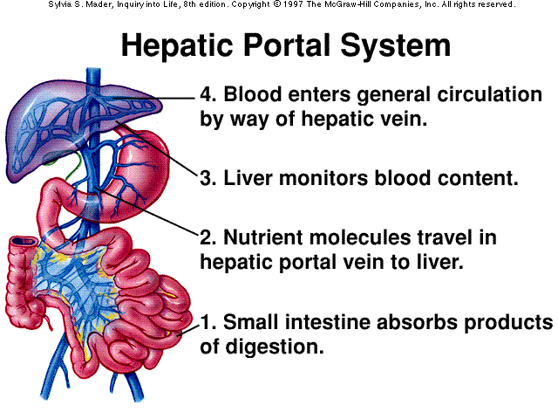
Hepatic Portal Circulation
Hepatic portal vein carries blood from one capillary network to another, namely from the GI to the liver. In the liver substances from the GI tract are processed before pushed out the hepatic vein into the inferior vena cava for circulation throughout the body

Slide 45
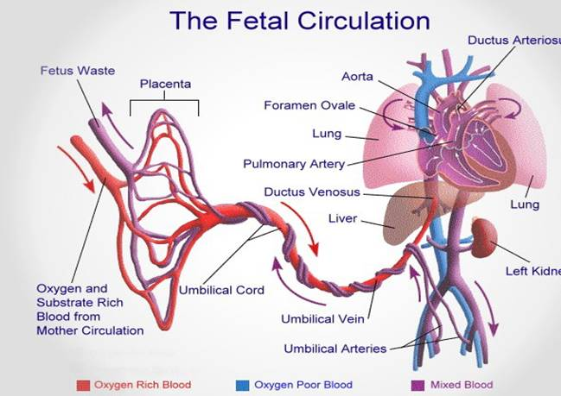
Fetal Circulation
Notes:
A fetus contains special structures that connect the developing fetus to the mother for materials exchange during prenatal development.
Maternal to fetal exchanges of materials occur through the placenta that is attached to the umbilical cord.
Blood passes from fetus to placenta through two umbilical arteries and returns to placenta through one umbilical vein.
We will discuss the other specific structures when we cover heart content in the next chapter.
These structures change postnatal because the lungs, kidneys, and GI organs are now are functional.

Slide 46
CHECKING CIRCULATION
Pulse → occurs through the alternate expansion and elastic recoil of an artery after each contraction and relaxation of the left ventricle
Normal range for pulse rate/heart rate
70 to 80 beats per minute at rest
Tachycardia → rapid resting heart or pulse rate over 100 beats/minute
Bradycardia → slow resting heart or pulse rate under 60 beats/minute
Notes:
Tak-i-KAR-de-a
Brad-i-KAR-de-a

Slide 47
Measurement of Blood Pressure
Blood pressure in clinical terms is the pressure in the arteries generated by the left ventricle during systole and the pressure remaining in the arteries when the ventricle is in diastole
BP is usually measured on the brachial artery in the left arm using a sphygmomanometer
Systole refers to the contraction of the heart
The first sound heard corresponds to systolic blood pressure (SBP), force with which blood is pushing against arterial walls during ventricular contraction.
The last faint sound hear corresponds to diastolic blood pressure (DBP), force exerted by the remaining blood in arteries during ventricular relaxation.
Normal blood pressure of a young adult male is 120mmHg systolic and 80mmHg diastolic.
In females the blood pressure is 8 to 10mmHg lower.
Notes:
The stroke volume is the volume of blood, in milliliters (mL), pumped out of the heart with each beat. Increasing either heart rate or stroke volume increases cardiac output.
Cardiac Output in mL/min = heart rate (beats/min) X stroke volume (mL/beat)
An average person has a resting heart rate of 70 beats/minute and a resting stroke volume of 70 mL/beat. The cardiac output for this person at rest is:
Cardiac Output = 70 (beats/min) X 70 (mL/beat) = 4900 mL/minute.
The total volume of blood in the circulatory system of an average person is about 5 liters (5000 mL). According to our calculations, the entire volume of blood within the circulatory sytem is pumped by the heart each minute (at rest). During vigorous exercise, the cardiac output can increase up to 7 fold (35 liters/minute)

